Slide 1
Guide to FIB spot diameter measurement
In order to get definition / human error size. Read this carefully (2 min) and afterwards proceed with the measurement (9 samples), using only the knowledge you gained in this guide. Do not spend more than several seconds on each measurement.

Slide 2
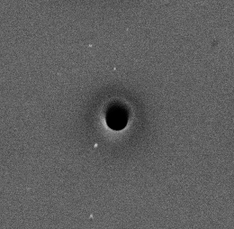
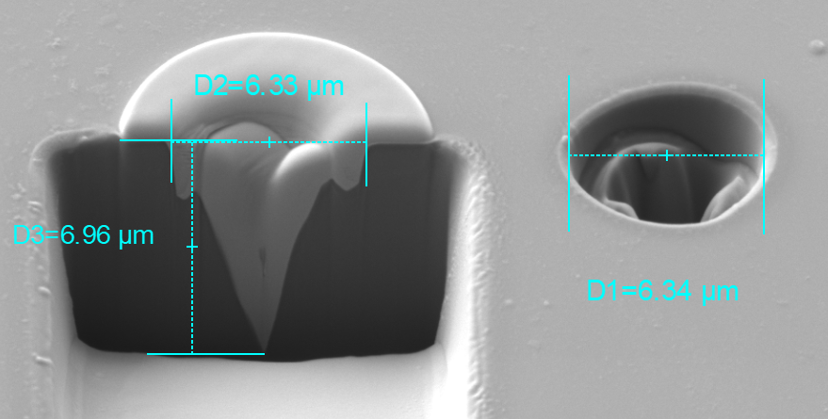
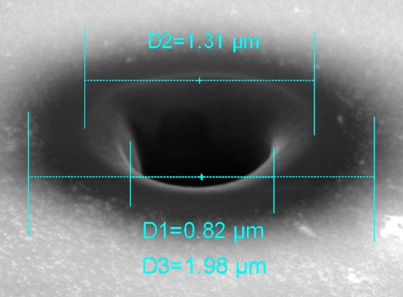
FIB spot
halo
tail
Typical FIB spot is composed of 3 parts – halo, tail, hole. We are interested in the hole size only.
As you can see, the exact hole diameter is hard to define and measure.
hole

Slide 3
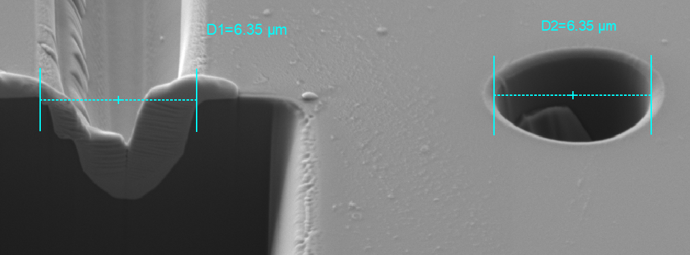
Current attempt at definition
Hole starts where tail ends in an inflection point – e.g. in the point where the slope of the hole changes rapidly, visible in SEM image by large change in B&C, e.g. „the inner edge“.
It should contain all the space in which the sample is being milled „substantially“.

Slide 4
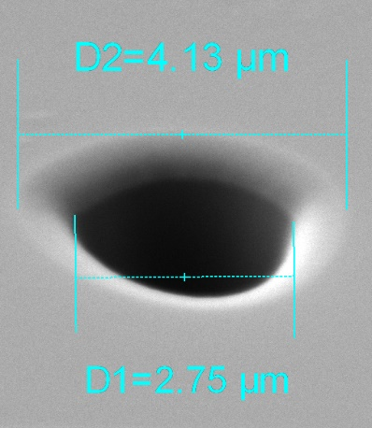
Example
„Correct“ measurement – D1
„Incorrect“ measurement – left edge of D1 is a little too much to the right.

Slide 5
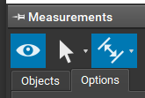
Measurement
Import images from S:\vaclav.ondracka\FIB spot samples into Essence.
Use mouse wheel to zoom in if needed.
To measure hole size, use the „measure distance“ tool from Essence -> Measurements. Hold Ctrl while defining the first vertical line to force it in exactly vertical direction.
Write measurements in an email to vaclav.ondracka@tescan.com in pixels. Scale & FIB preset names were removed on purpose.
Example: Sample1 : 15.4

